Slide 1


Movie Sales Analysis
(2006 – 2016)
Team Members : Gayatri Borate
Guided By : Prasad Charate

Slide 2

About Us
Background : BSC(Computer Science) from Savitribai Phule Pune University, Pune
Why you want to learn Data Science : Data Science offers continuous learning and growth. As new technologies and methods evolve, it encourages me to stay curious, adaptable, innovative and qualities that are essential for a successful career in today’s technology landscape.
Any work experience : Freshers
LinkedIn and GitHub profile URLs :
Gayatri Borate :
LinkedIn : http://www.linkedin.com/in/gayatri-borate-853907367
GitHub : https://github.com/gayatriborate16/Gayatri-Borate.git

Slide 3
Agenda
Project Overview :
Data Overview
Dataset Purpose
Data Preparation
Data Model & Relationship View
Key Visuals & Insights
Final Dashboard
Business Insights
Conclusion

Slide 4
Project Overview
Data Overview/Brief :
The dataset is sourced from IMDB movie records and contains detailed information about movies released over multiple years. Each record includes attributes such as movie title, release year, genre, runtime, rating, revenue, votes, directors, and actors. Since some columns contained multiple values (such as genres and actors), the dataset was normalized into multiple related tables to ensure accurate analysis.
Dataset Purpose :
Find out which genres, actors, and directors are most popular
Study how movie box office revenue changes over time
Understand audience interest using movie ratings and votes
Analyze how movie runtime, ratings, and revenue are related
Present clear insights using interactive visualizations

Slide 5
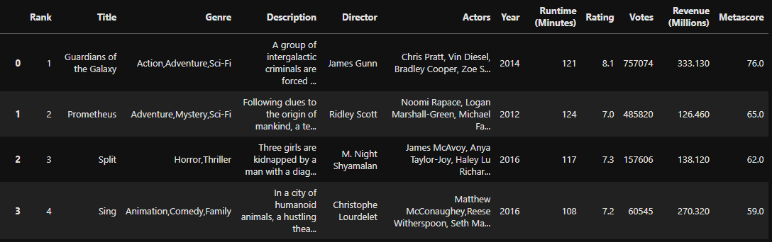
Data Preparation
We cleaned the dataset by removing duplicates, handling missing values, and correcting data types.
Multi-value columns like genres and actors were split into separate tables .
This is the dataset after removing null and duplicate values

Slide 6
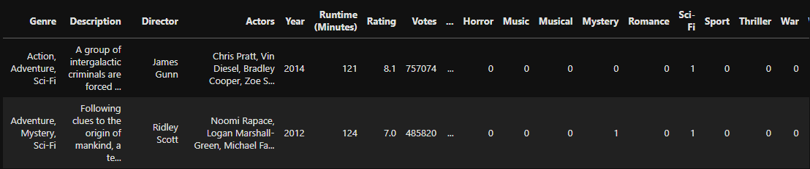
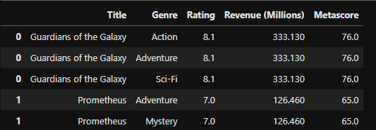
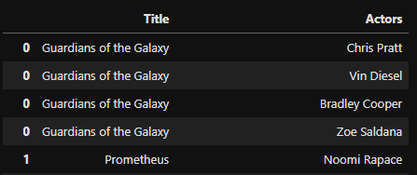
movies_main – contains movie-level details (title, year, runtime, revenue, rating, votes)
movies genre – maps each movie to its genres
movies actors – maps each movie to its actors

Slide 7
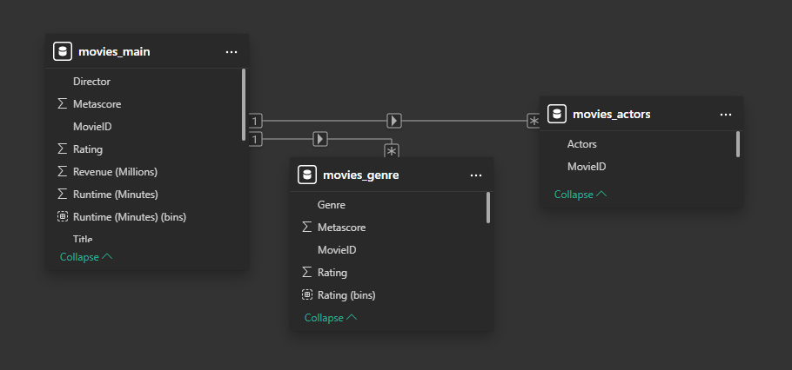
Data Model & Relationships View
Created one-to-many relationships using MovieID
Followed a star-schema-like structure for efficient analysis

Slide 8
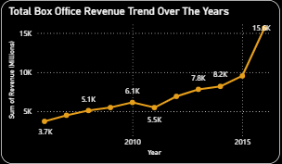
Key Visuals What is the Trend in the Box Office Revenue Over the Years ?
Insights :
The movie industry has experienced steady growth over time,
with a significant revenue peak in recent years.

Slide 9
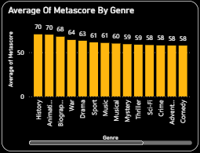
What is the Average Metascore for each Genre ?
Insights :
Genres like History, Biography, and Drama are rated highly by critics, while fun and entertainment-focused genres such as Comedy and Crime usually get lower critic scores.

Slide 10
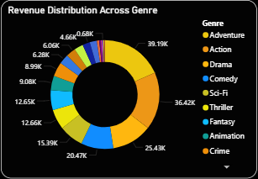
How is Total Revenue Distributed Among Various Genres ?
Insights :
Action and Adventure genres generate the highest box office revenue where as Drama remains a consistent revenue contributor and Niche genres like Animation, Fantasy, and Crime contribute smaller shares

Slide 11
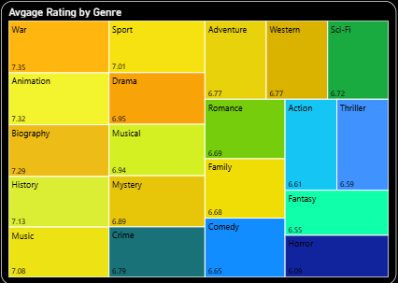
What is the Average Rating Across Genres ?
Insights :
War, Animation, and Biography have the highest average ratings, indicating these genres are generally better received by audiences and critics
Drama and Romance fall in the mid-rating range, showing consistent but moderate audience appreciation across years.
Action, Thriller, and Fantasy show comparatively lower average ratings, suggesting that popularity does not always translate into higher audience satisfaction.

Slide 12
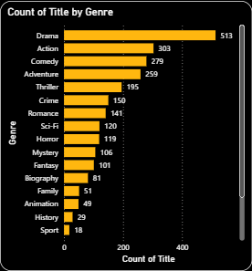
How are Movies Distributed Across Different Genres ?
Insights :
Drama dominates movie production, having the highest number of titles, showing it is the most frequently produced genre.
Comedy and Action also have high movie counts, indicating strong industry focus on entertainment-driven content.
Niche genres like History, Sport, and Animation have very few releases, suggesting limited production or specialized audience demand.

Slide 13
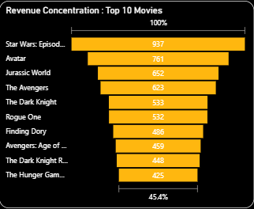
How Does Revenue Progress from all Movies to the Top 10 Highest-Grossing ones ?
Insights :
Box office revenue is highly concentrated in a few blockbuster movies
Franchise films dominate the top earners
Top 10 movies together contribute a large amount of overall revenue.

Slide 14
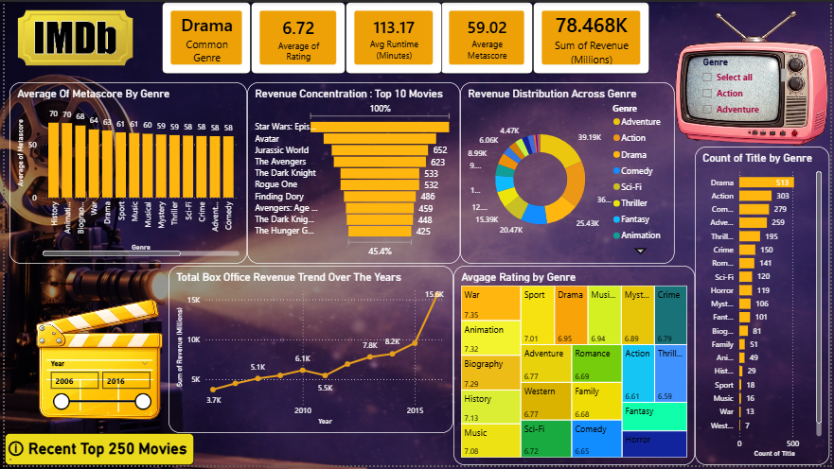
Final Dashboard

Slide 15
Business Insights
Box office revenue shows a consistent upward trend over the years.
Top blockbuster movies contribute a major share of total revenue.
Action, Adventure, and Drama are the most profitable genres.
History and Biography films receive higher ratings but lower revenue.
Comedy and Crime have high movie counts but lower average returns.
Higher audience votes usually lead to higher revenue.
Movies with average runtimes perform better commercially.
Franchises and sequels outperform standalone movies.
Star directors and actors strongly influence box office success.
Combining quality storytelling with mass appeal drives maximum profit.

Slide 16
Conclusion :
This project highlights how movie success is influenced by a combination of box office performance, genre popularity, audience ratings, and key contributors like actors and directors.
The analysis shows that while blockbuster genres generate higher revenue, critically acclaimed genres achieve better ratings.
Overall, the insights from this dashboard help identify profitable trends, audience preferences, and strategic opportunities for future movie production and investment decisions.

Slide 17

THANK YOU

